Slide 1

Customers Line up Software Engineering Project 2020/2021
MULLAIVENTHAN ANNA DURIA – 883406
SHAHRUKH AHMED IRFANI - 874143
POLITECNICO DI MILANO

Slide 2

Objective of application:
Main objective of this application:
The coronavirus emergency has put a strain on society on many levels, due to many countries imposing lockdowns that allow people to exit their homes only for essential needs.
The goal of this project is to develop an easy-to-use application
on the one side, allows store managers to regulate the influx of people in the building.
on the other side, saves people from having to line up and stand outside of stores for hours on end.
POLITECNICO DI MILANO

Slide 3
Requirements description:
It would allow customers to “line up” retrieve a number from their home.
The application could be used to generate QR codes that would be scanned upon entering the store.
Thus allowing store managers to monitor entrances.
Fallback options should be available for people who do not have access to the required technology.
For example, stores should also have the possibility to hand out “tickets” on the spot, thus acting as proxies for the customers.
The application could also allow customers to “book” a visit to the supermarket.
Hence, upon booking a visit, a customer might indicate also the approximate expected duration of the visit.
The application might also allow users to indicate, if not the exact list of items that they intend to purchase, the categories of items that they intend to buy.
Other features that the application might have include a suggestion of alternative slots in the same day, or in different days for visiting the store, to balance out the number of people in the store.
The suggestion of different stores of the same chain or even of different chains.
POLITECNICO DI MILANO

Slide 4
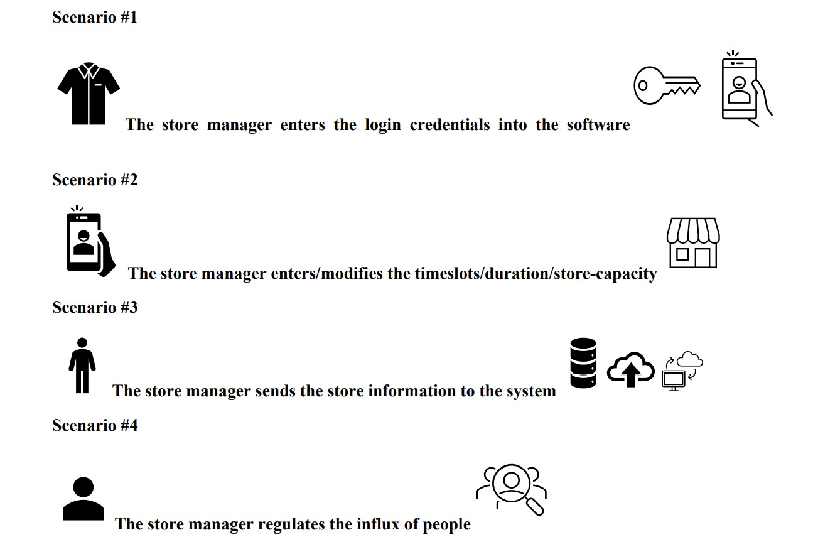
Scenarios:
POLITECNICO DI MILANO

Slide 5
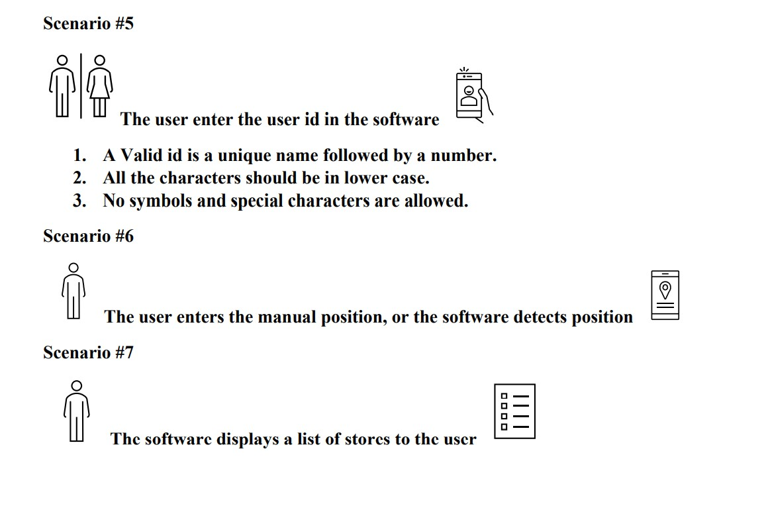
Scenarios:
POLITECNICO DI MILANO

Slide 6
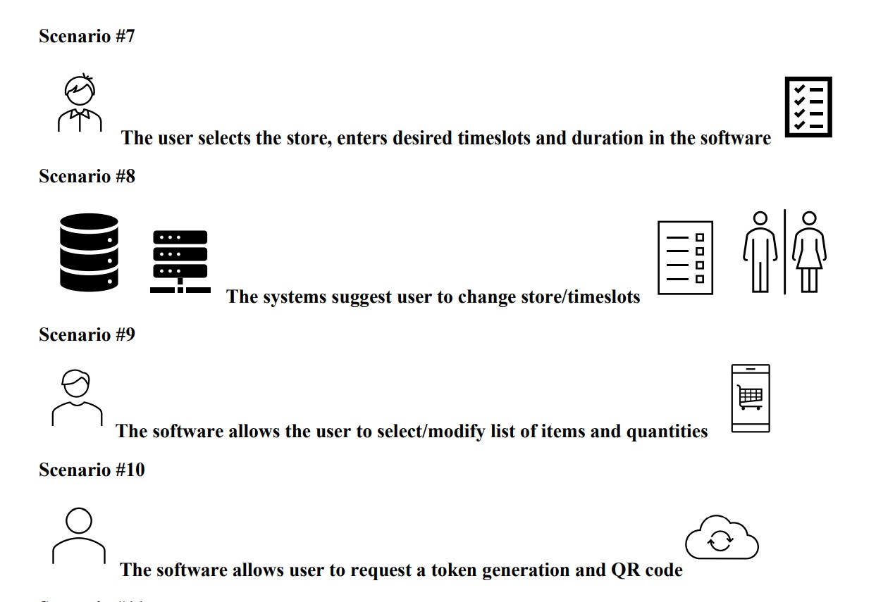
Scenarios:
POLITECNICO DI MILANO

Slide 7
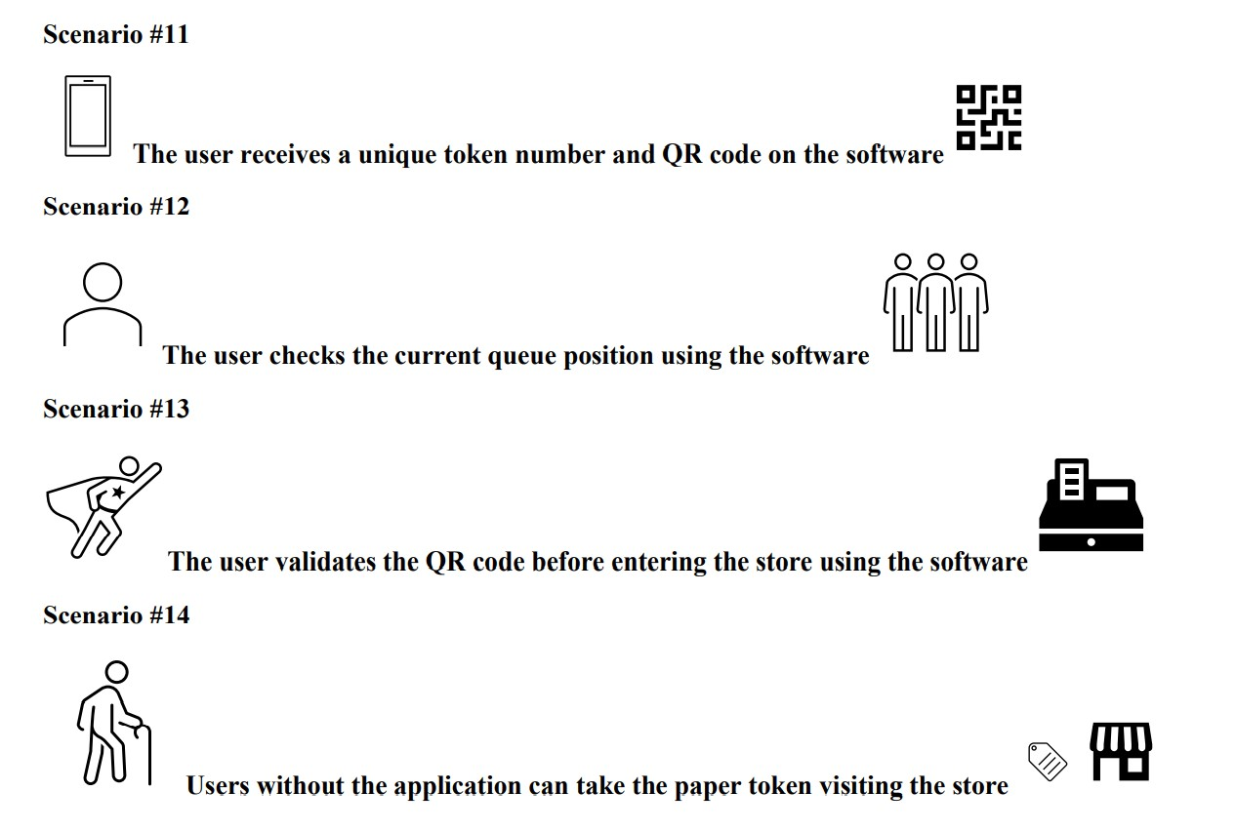
Scenarios:
POLITECNICO DI MILANO

Slide 8
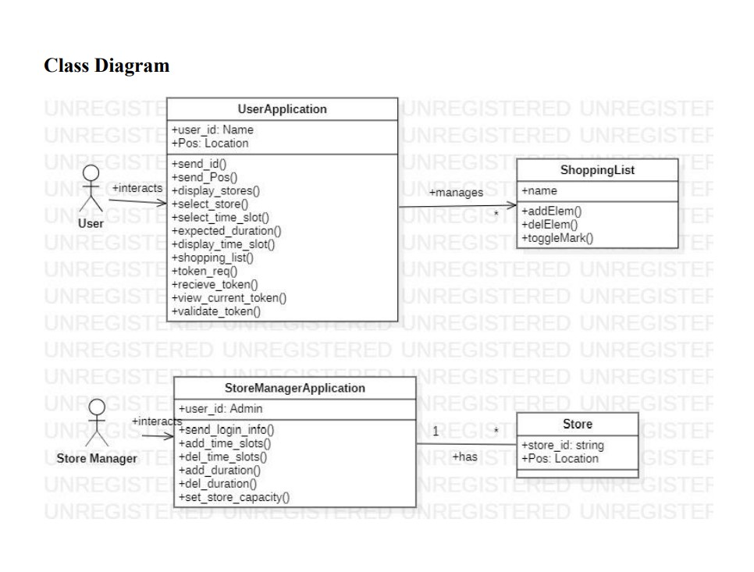
Requirements class diagram:
POLITECNICO DI MILANO

Slide 9
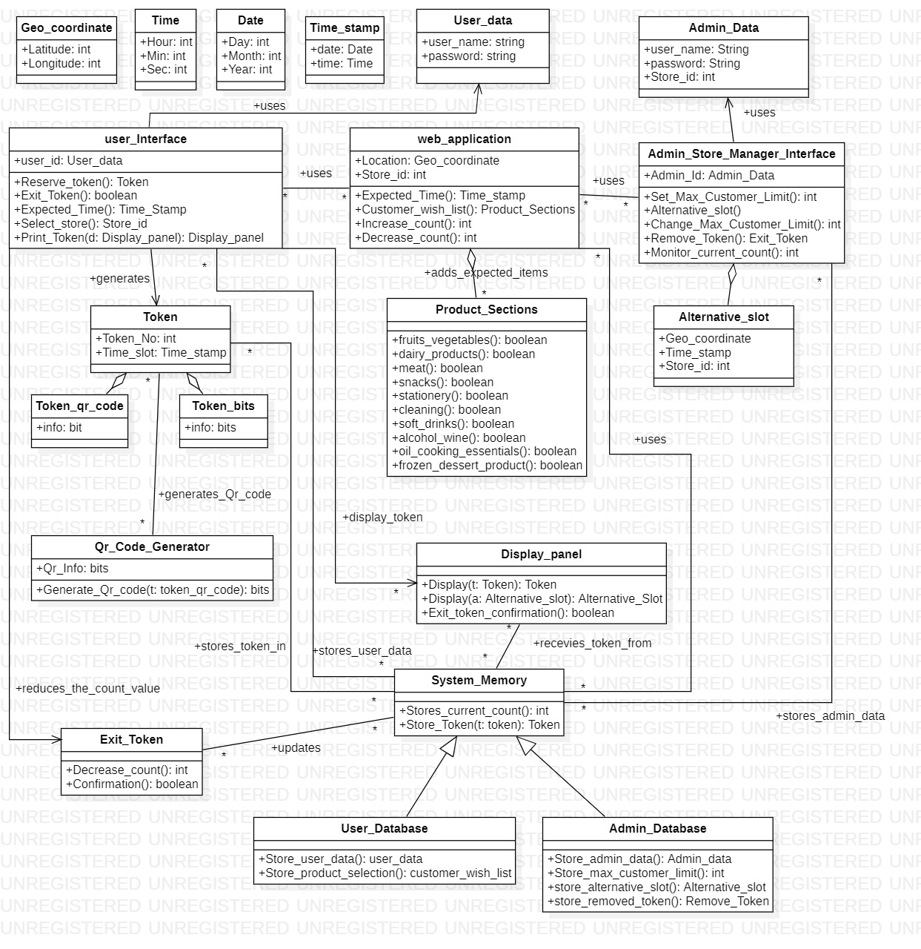
Design UML diagram:
POLITECNICO DI MILANO

Slide 10
Components of UML diagram:
User
User interface
Supermarket sales application
Product sections
Admin store manager interface
Alternative time slot
Token
QR code generator
System memory
User database
Admin database
Display panel
Exit token
POLITECNICO DI MILANO

Slide 11
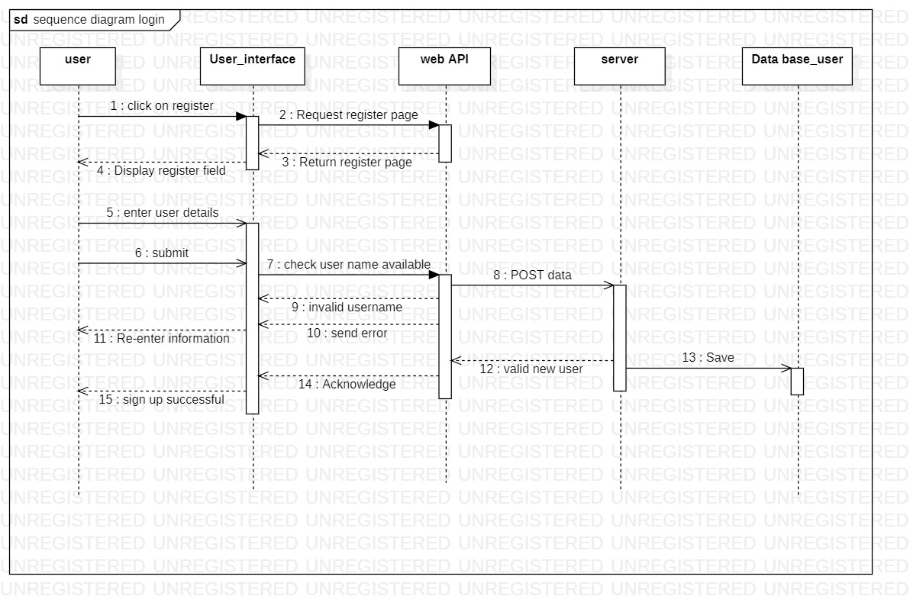
Login signup sequence diagram:
POLITECNICO DI MILANO

Slide 12
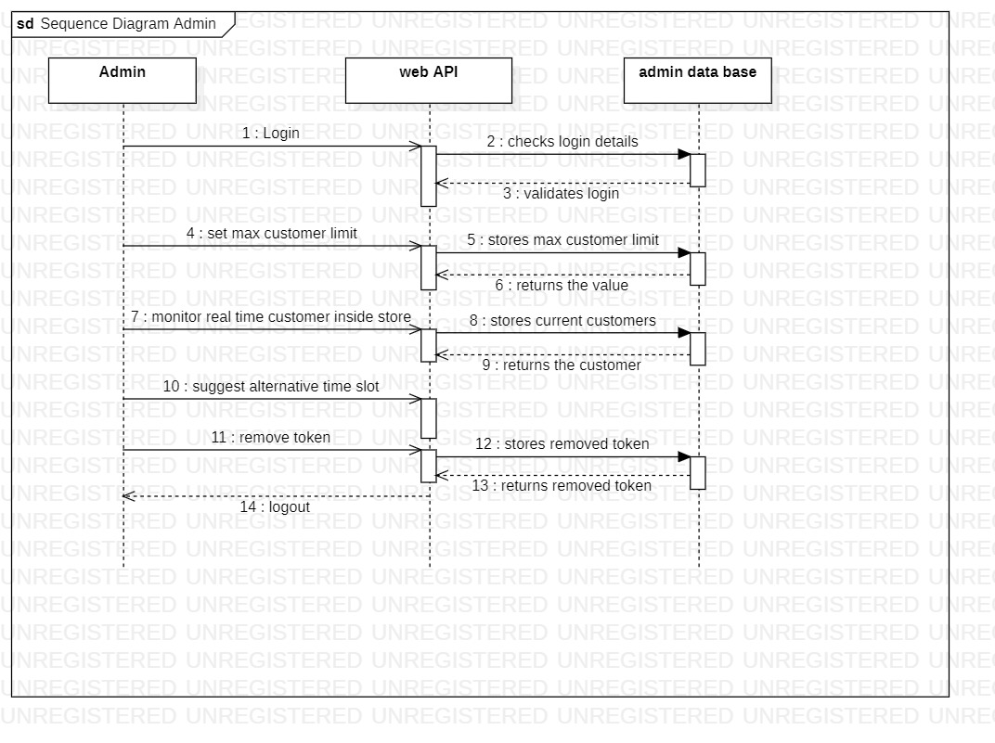
Sequence diagram Admin:
POLITECNICO DI MILANO

Slide 13
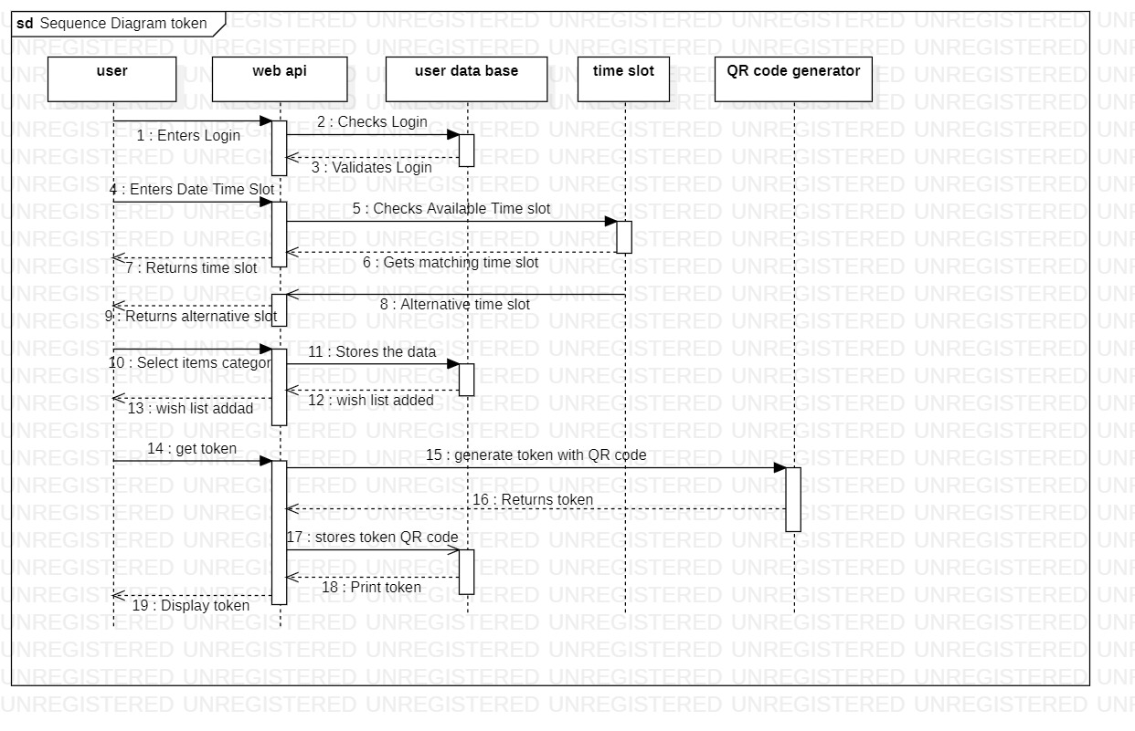
Sequence diagram for booking token:
POLITECNICO DI MILANO

Slide 14
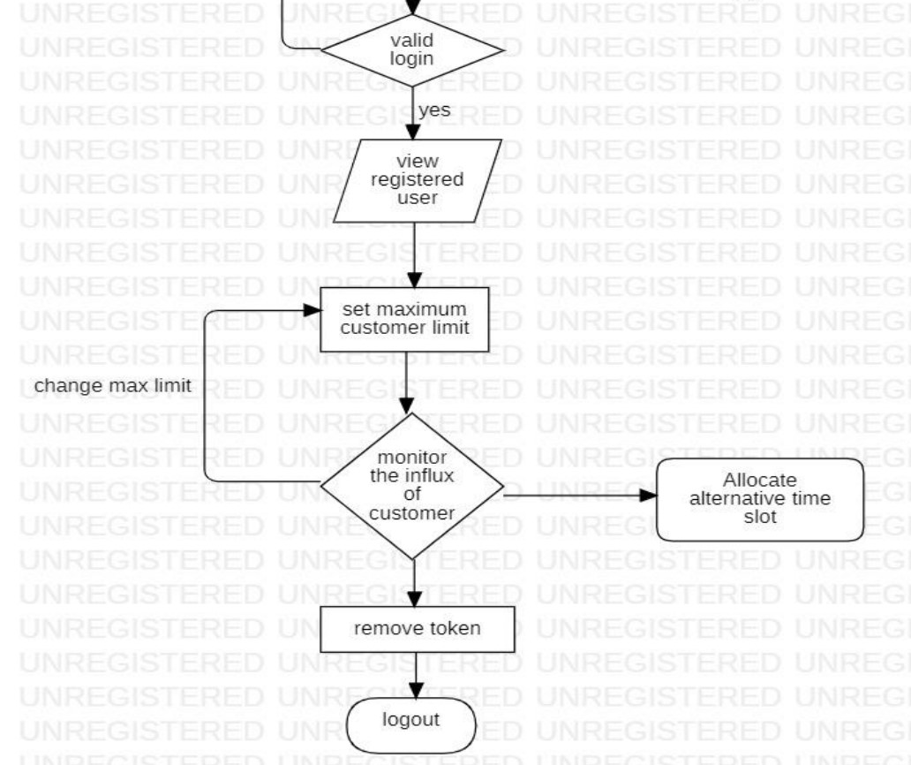
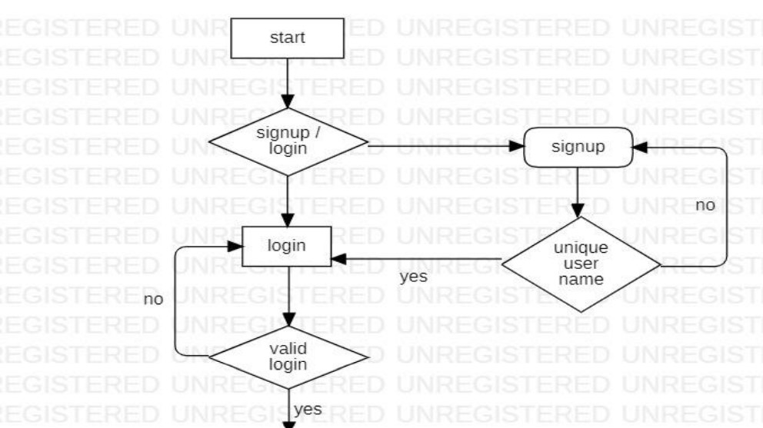
Flow Chart Diagram:
Admin signup-login
Admin control part
POLITECNICO DI MILANO

Slide 15
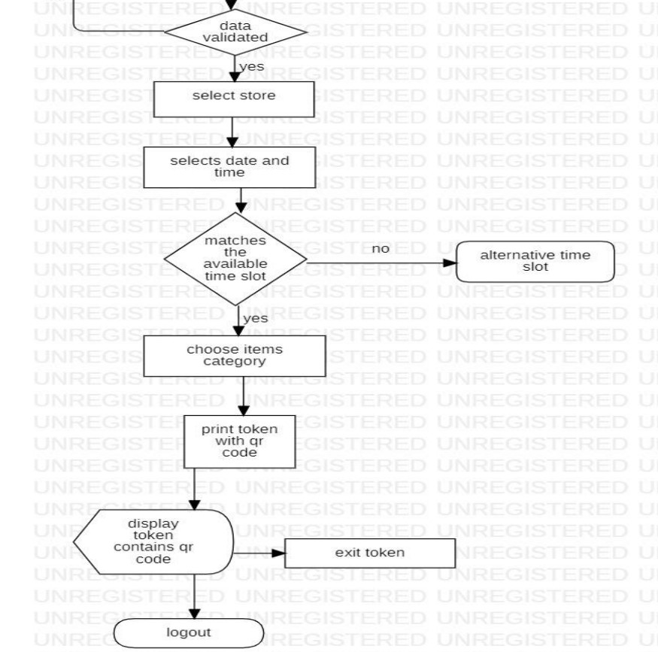
Flow chart diagram:
User signup login
User action part
POLITECNICO DI MILANO

Slide 16
Clup implementation:
We used xampp control panel software for the server.
All the files are created with the help of sublime text editor in php format.
Google chrome was used as the browser for the implementation and testing purpose.
Mysql was used for storing our admin and customers data in the data base.
Our data base name: login_sample_db
We have two tables inside that data base.
Table1: users
id-(primary key-auto increment-data type: int)
user_name-(data type: varchar)
password-(data type: varchar)
date-(data type: timestamp)
Table2: tokens
id-(primary key-data type: int)
token-(data type: varchar)
POLITECNICO DI MILANO

Slide 17
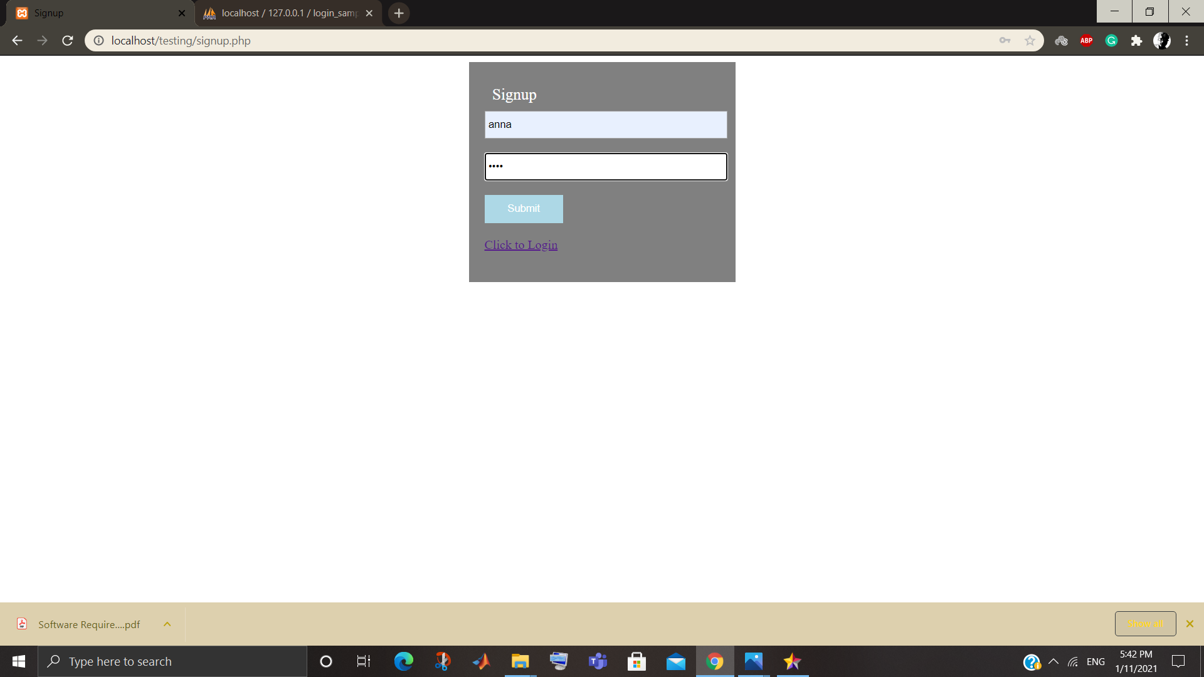
Clup testing:
Username: anna
Password: 1234
Submit
After submitting it redirects to log in page.
POLITECNICO DI MILANO

Slide 18

Clup testing:
Username: anna
Password: 1234
Submit
After submitting, it goes to index page.
POLITECNICO DI MILANO

Slide 19
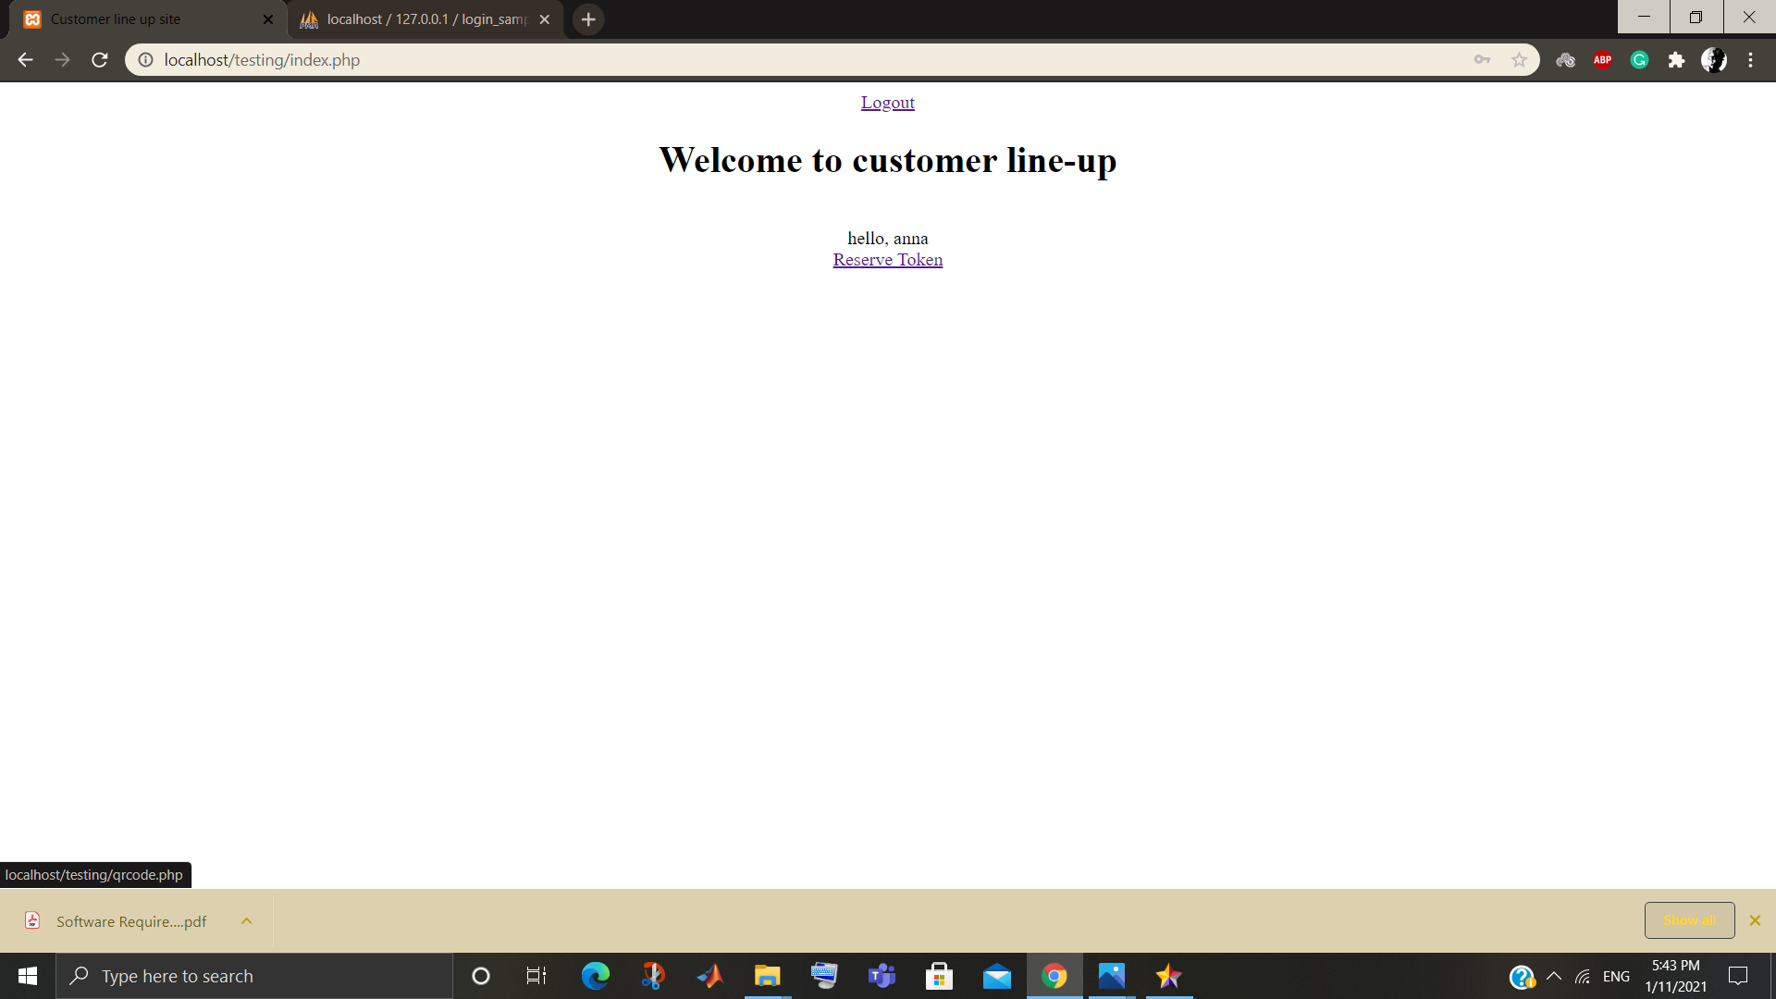
Clup testing:
Home page will show the username.
If she clicks, reserve token.
It goes to next page.
POLITECNICO DI MILANO

Slide 20
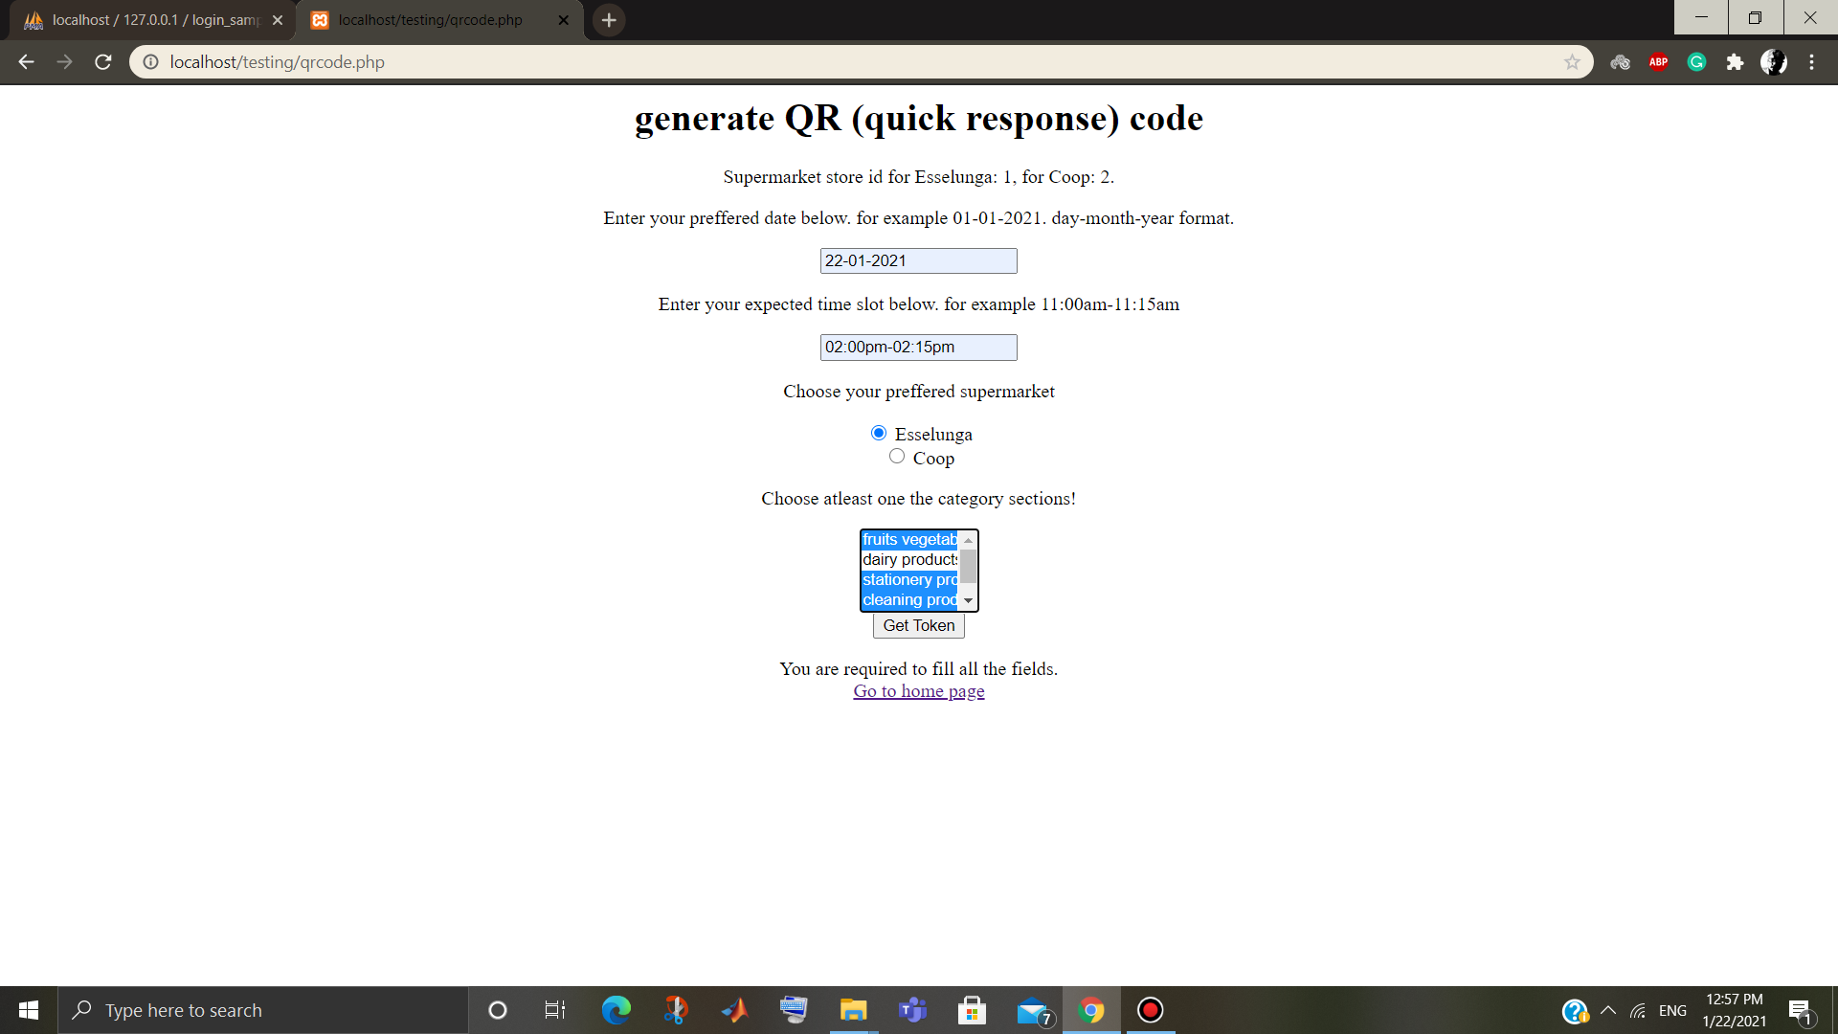
Clup testing:
User must give the date.
User must mention time in the requested format.
User must choose the preferred supermarket.
User must choose category section.
After completing the all field. He can submit the form.
This will generate the QR code below.
POLITECNICO DI MILANO

Slide 21
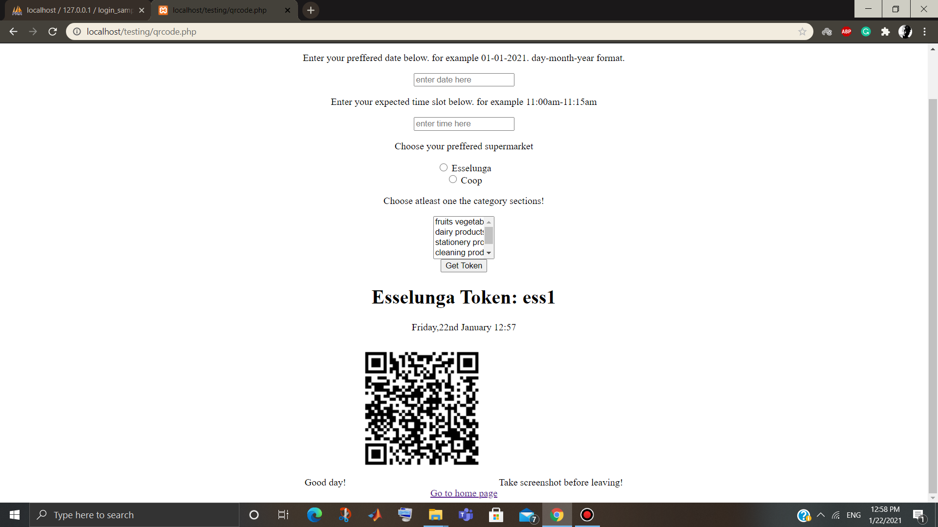
Clup testing:
Qr code consists of all the data which user submitted.
Her token number is ess1.
It represents her token number in the queue.
For esselunga it is like ess as prefix.
It also shows date and time while generating the qr code.
If user click the go to home page link.
It goes to the home page.
POLITECNICO DI MILANO

Slide 22
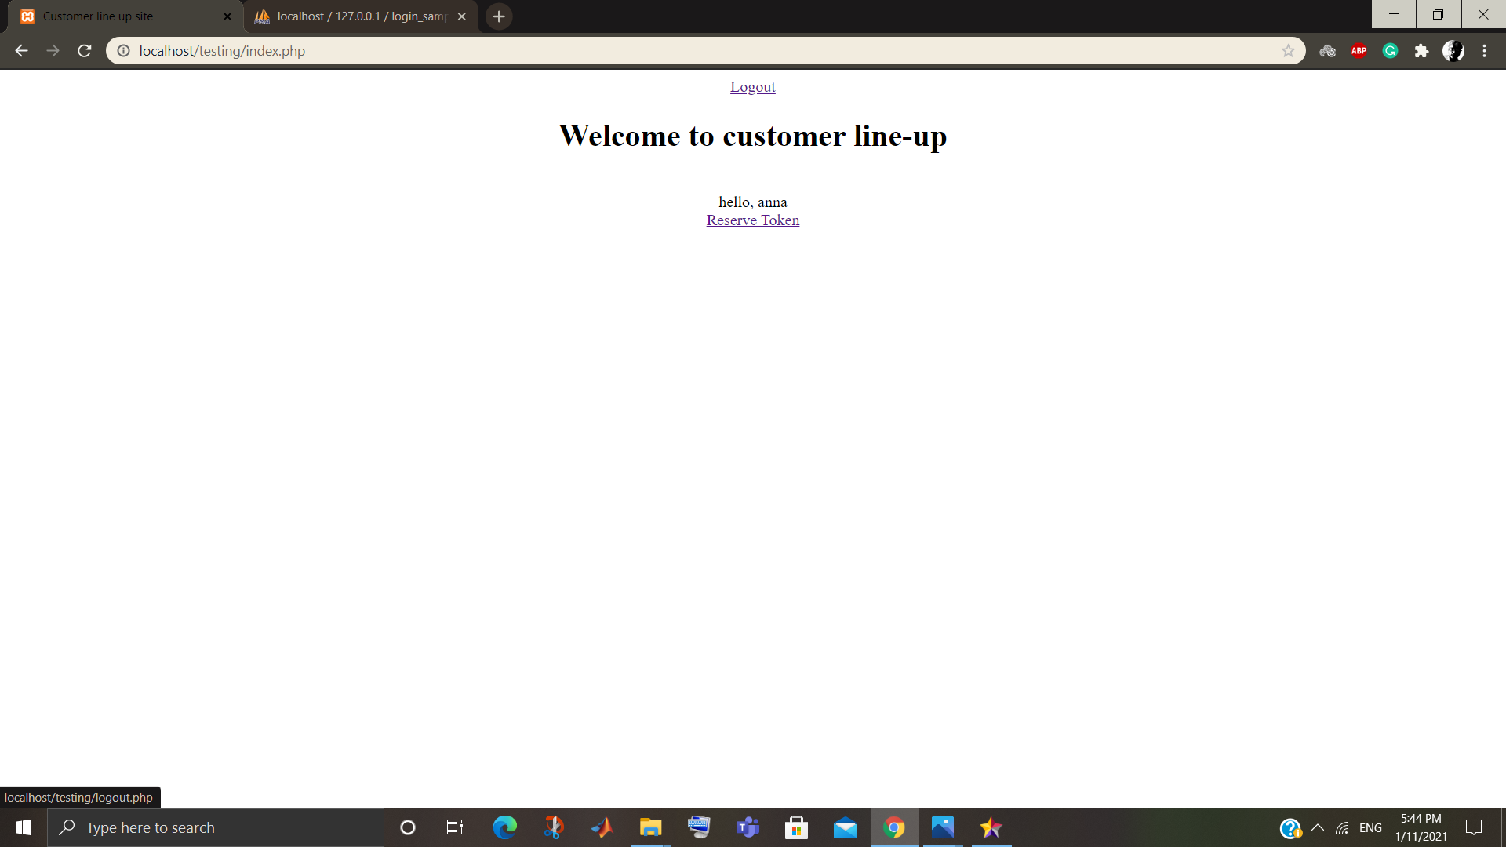
Clup testing:
Finally, the user anna can logout by clicking the logout link.
POLITECNICO DI MILANO

Slide 23
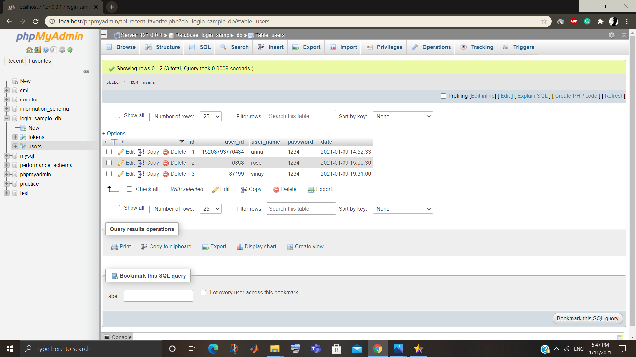
Mysql data base: user
POLITECNICO DI MILANO

Slide 24
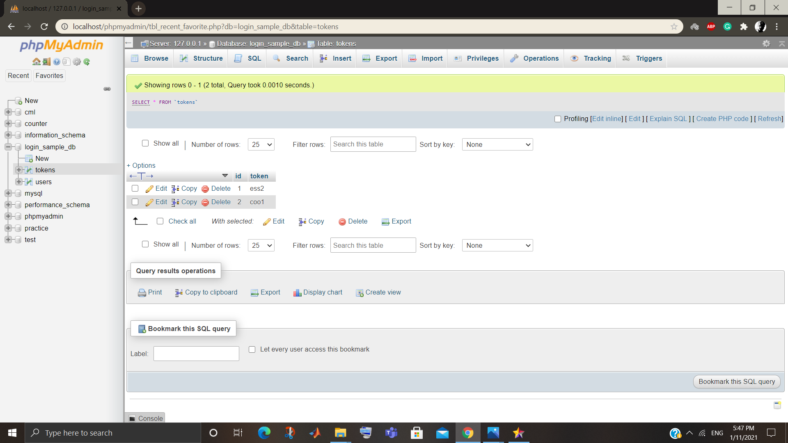
Mysql data base: token
POLITECNICO DI MILANO

Slide 25
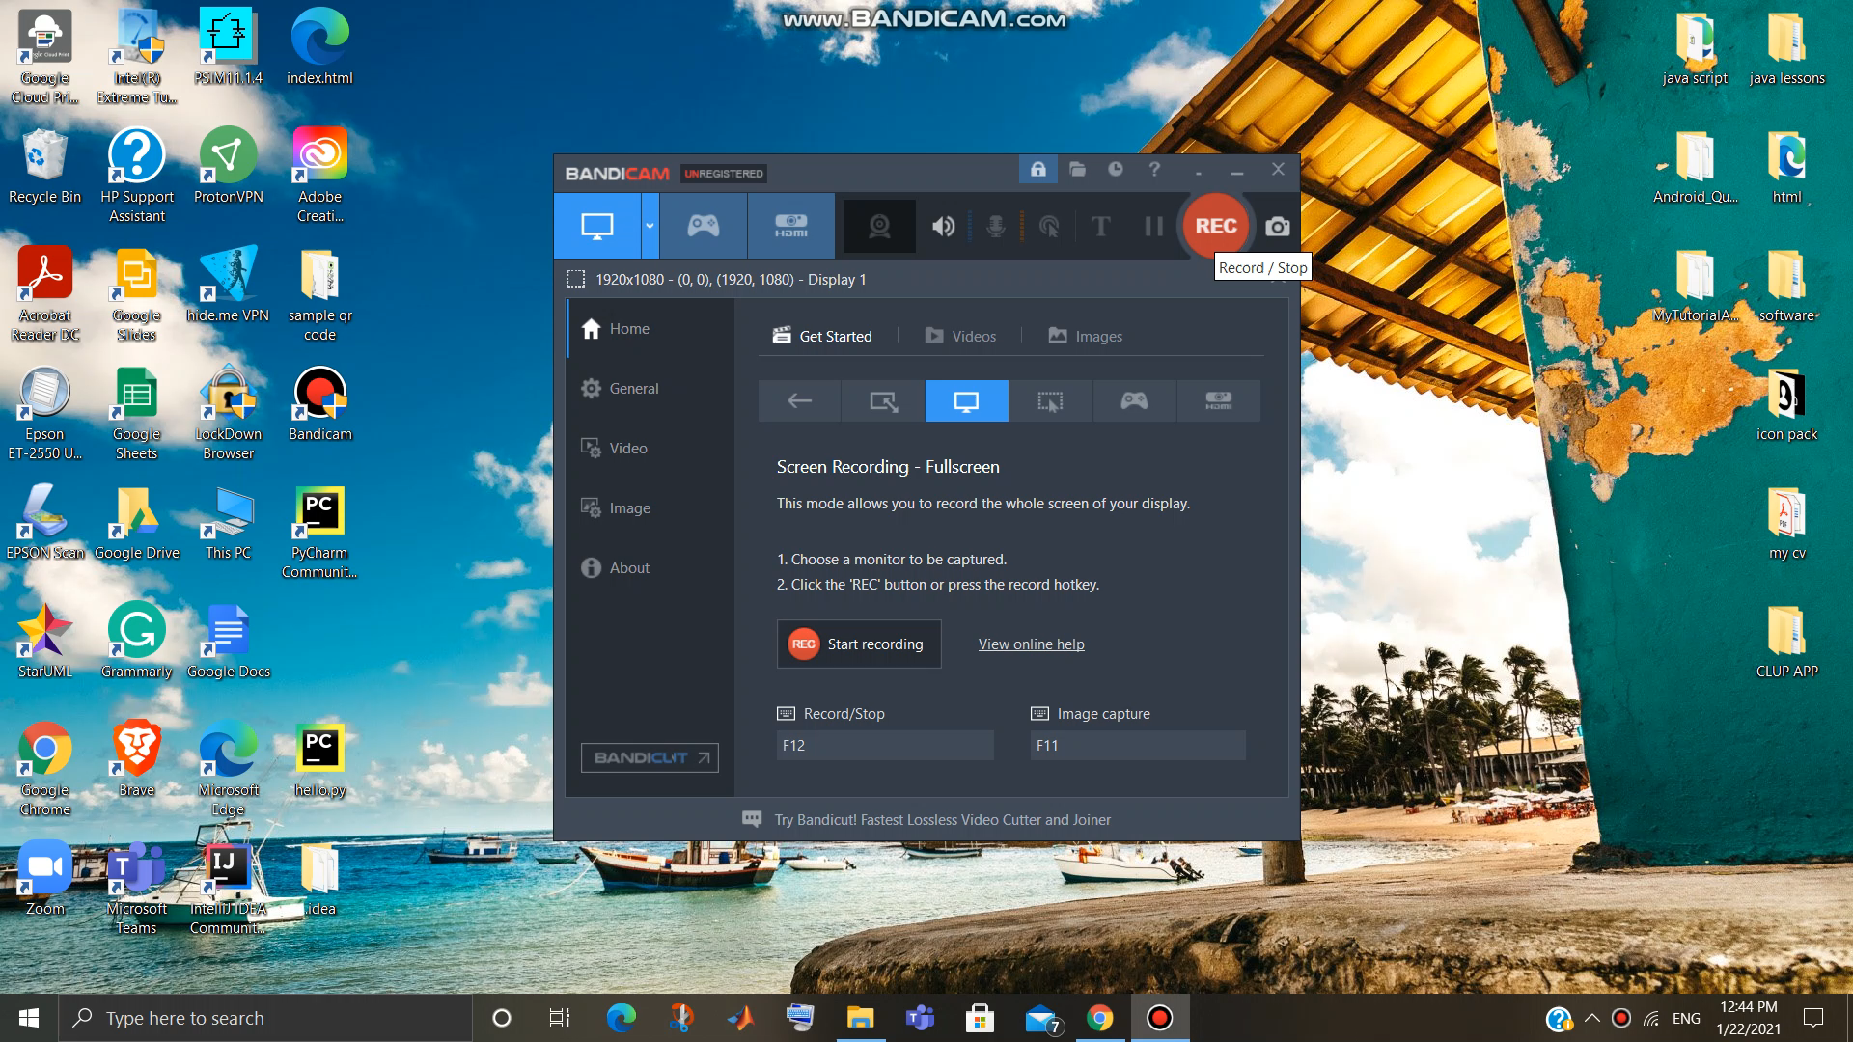
Video playback of clup:
POLITECNICO DI MILANO

Slide 26
Future work:
Till now we have developed an application that is capable to book a visit to available supermarket.
Customer can also generate a QR code with token number on it.
QR contains the data of wish list of sections which user would like to buy.
In the next phase (i.e., in future)
we will improvise the application by adding a separate data base for admin to manage the traffic in real time.
POLITECNICO DI MILANO

